Slide 1

Rapid prototyping data products using Shiny
rstudio::conf 2018
2017-02-02

Slide 2




Speaker profile
Tanya Cashorali
@tanyacash21
2004
2005
2006
2007
2012
2013
2014
2015
Notes:
R 2005 story,

Slide 3
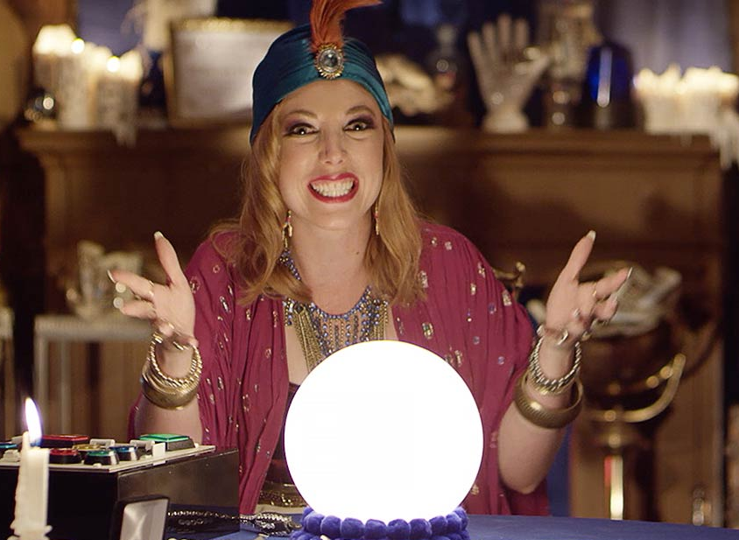
humans are not fortune tellers
Of course I knew there wouldn’t be enough data in Oglala Lakota County when I wrote the 25 page requirements doc!
Missing Data
Delimiters!!1
\t;||
Nonlinearity
Outliers
Collinearity

Slide 4
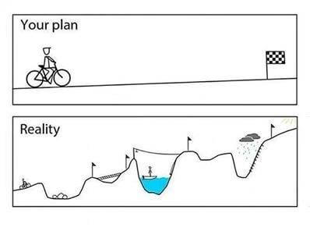
We’re not building aston martins
“Laugh at perfection. It’s boring and keeps you from being done.”

Slide 5
The done manifesto
There are three states of being:
Not knowing
Action
Completion.
“Pretending you know what you’re doing is almost the same as knowing what you are doing, so just accept that you know what you’re doing even if you don’t and do it.”
http://www.manifestoproject.it/bre-pettis-and-kio-stark/
https://www.bakadesuyo.com/2015/09/impostor-syndrome/
Notes:
Number 1 of the done manifesto

Slide 6
Case studies

Slide 7
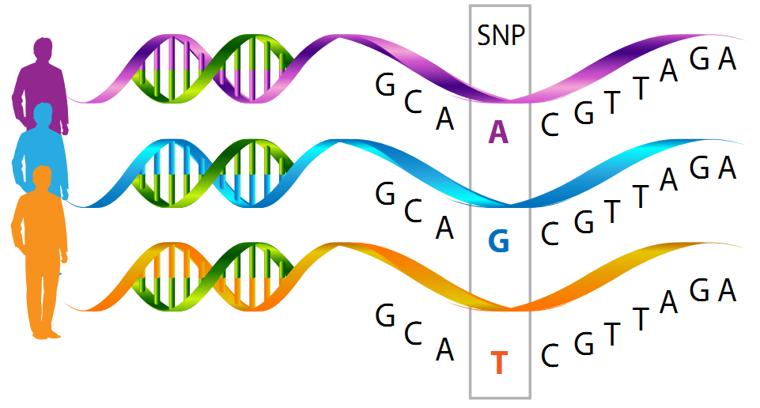
1.6 billion documents
Problem
Need to enable scientists to query 1.6 billion “documents” (SNP + phenotype combinations) quickly and filter based on significance and various other filters.
Notes:
Single nucleotide polymorphisms, frequently called SNPs (pronounced “snips”), are the most common type of genetic variation among people. Each SNP represents a difference in a single DNA building block, called a nucleotide. For example, a SNP may replace the nucleotide cytosine (C) with the nucleotide thymine (T) in a certain stretch of DNA.
SNPs occur normally throughout a person’s DNA. They occur once in every 300 nucleotides on average, which means there are roughly 10 million SNPs in the human genome. Most commonly, these variations are found in the DNA between genes.

Slide 8
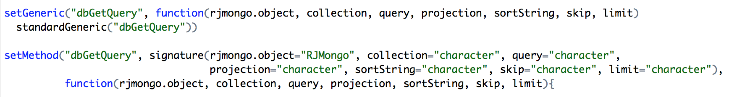
Custom rmongo package
RMongo package built in Scala did not support authentication for Mongo 3.0
So we built an RJMongo package using Java = ACTION!
That same issue still isn’t resolved – originally reported in June 2015
Notes:
We had authentication issues with Rmongo and Mongo 3.0, package was built in scala, we re-built it in java. Still wasn’t resolved 1 year later (jun 2015 when I reported, still open today)

Slide 9
Performance?
In order to improve query performance… dataTableAjax() to the resuce!
action <- dataTableAjax(session, result,rownames = FALSE,filter = function(data, params) {
q = params
data=dataFromMongo(qs,q$search,q$start,q$length,q$column,q$order)
list(
draw = as.integer(q$draw),
recordsTotal = recordCount,
recordsFiltered =recordCount ,
data = unname(as.matrix(data)),
DT_rows_all = 5
)
})
widget <- datatable(result,
rownames = FALSE,
class = 'display cell-border compact',
selection = 'none',
options = list(ajax = list(url = action),scrollX = TRUE,serverSide = TRUE,stateSave = TRUE, escape=FALSE,filter=FALSE,processing=TRUE,language = list(processing = "<img src='spin.gif'>"),columnDefs = list(list(targets = c(0:4,6:25),sortable = FALSE)),order = list(list(5,'asc')))
)
* https://www.rdocumentation.org/packages/DT/versions/0.2/topics/dataTableAjax
Notes:
It is basically an implementation of server-side processing of DataTables in R.
Also set up auth using the copmany’s single-sign on

Slide 10
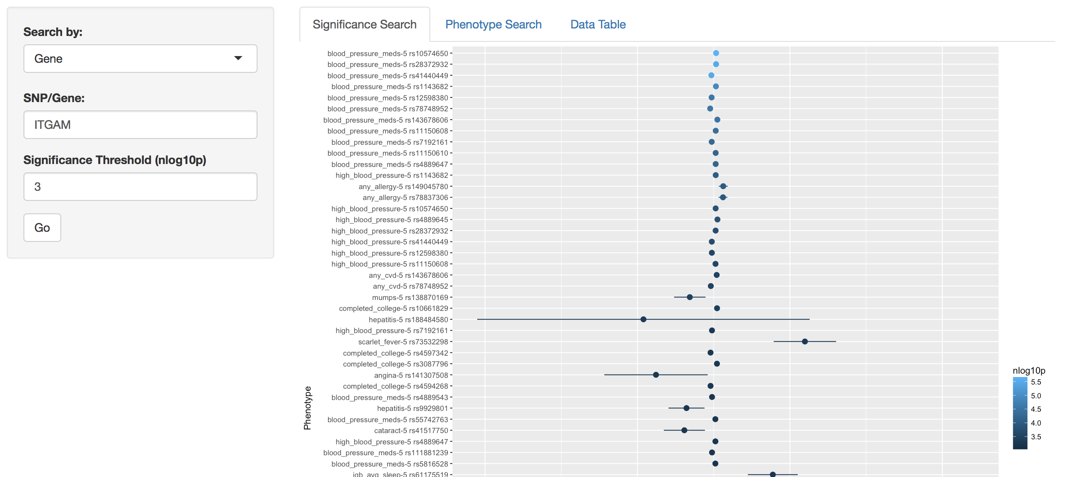
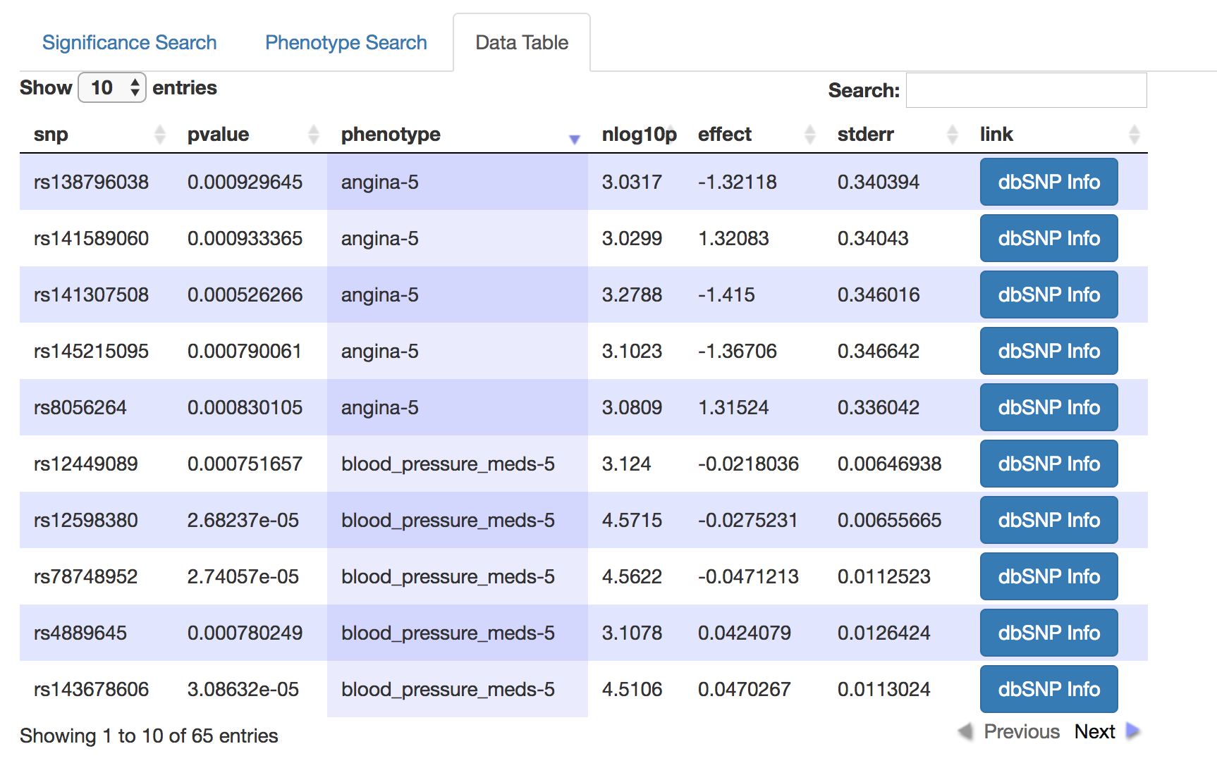
First version
“Accept that everything is a draft. It helps to get done.”
Notes:
Full web dev team would take much longer

Slide 11
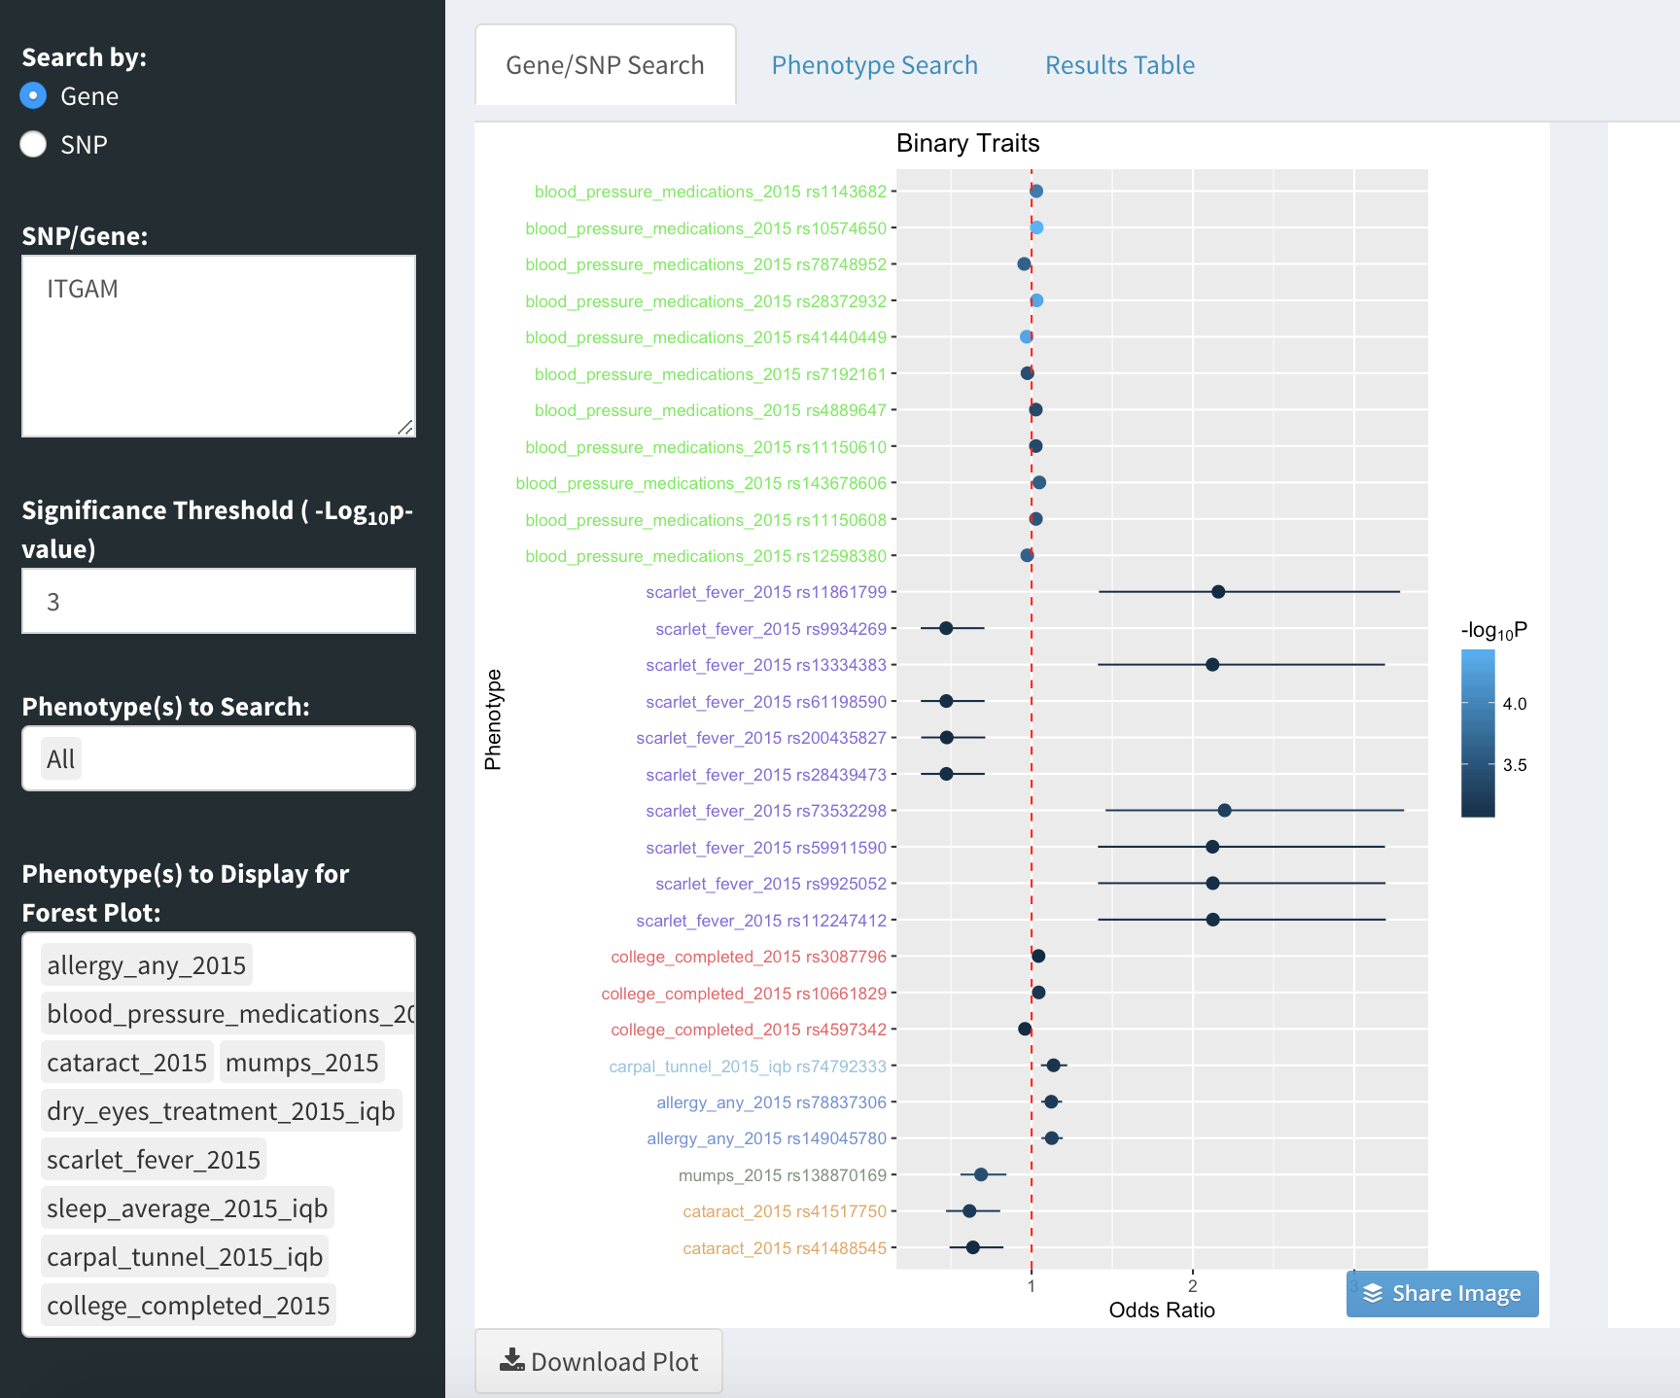
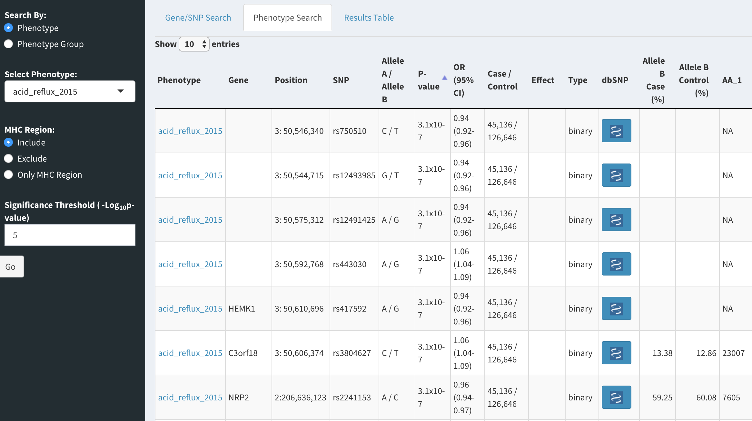
Current product

Slide 12

Let’s add 2.5 billion more!
One node cluster w/ 512GB of RAM
Current data size ~3 terabytes in JSON format
“Done is the engine of more.”
Notes:
2 years later! Still being used and wanting to expand upon. Shiny infrastructure is there though.

Slide 13
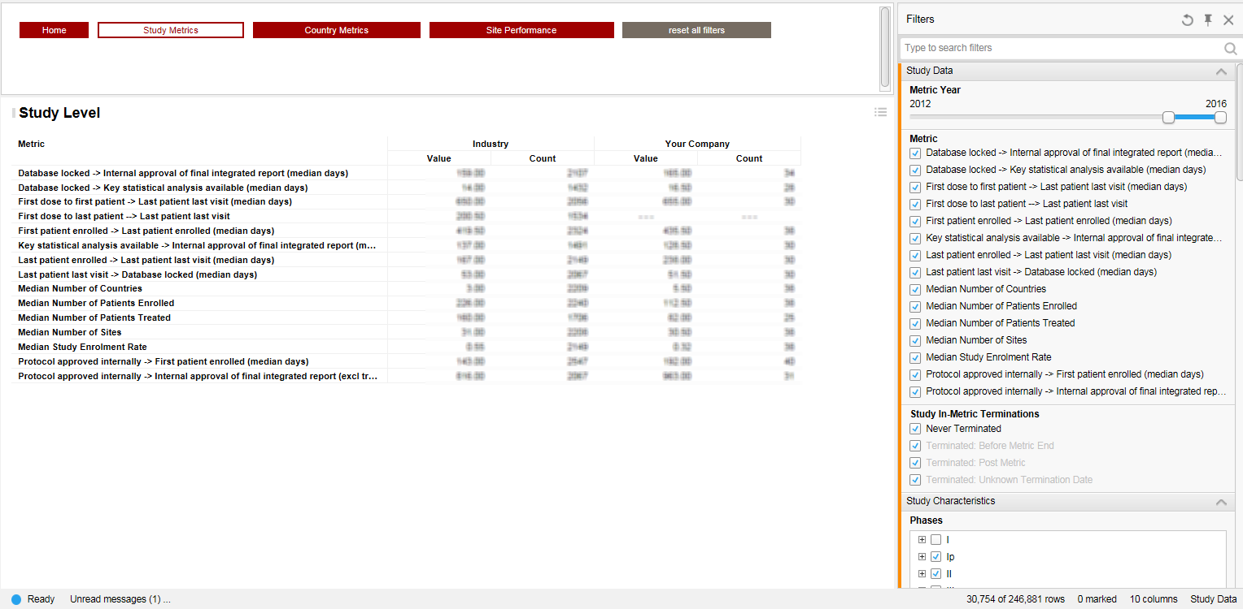
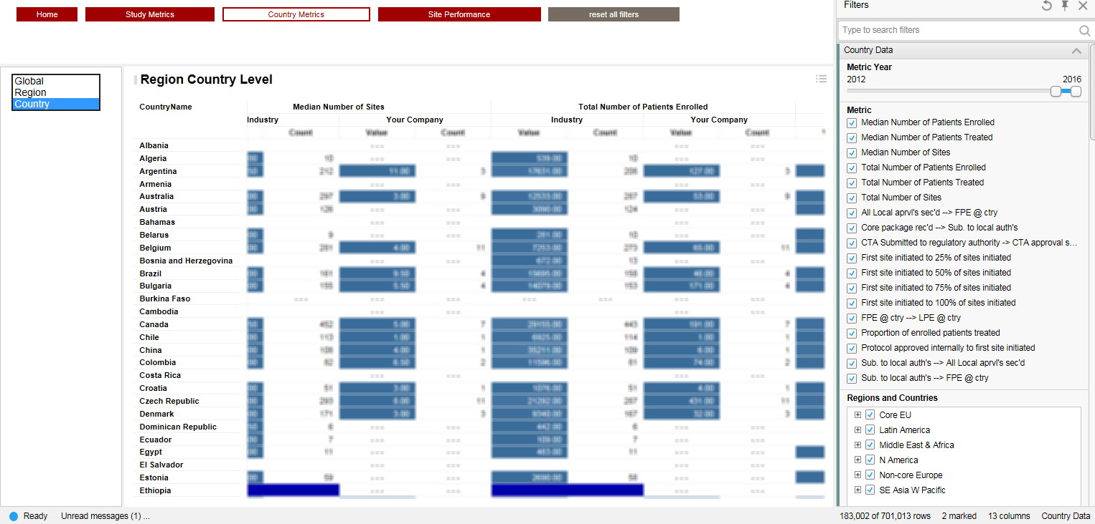
Cmr api
Problem – API access to data from Centre for Medicines Research (CMR) International, which provides pharmaceutical industry metrics and trends analysis.
Issues:
Clunky API
Tons of parameter combinations and results returned in aggregate
Time-consuming
IT dumped some of the data
Slow
Poor usability on their GUI (filters are clunky)
Ineffective visualizations
Data extracts contain limited details and were difficult to use
Notes:
What are the latest trends in R&D productivity across the industry?
What are the key factors that influence R&D productivity?
How do different companies compare — with the industry, with competitors?
What are the latest trends in industry pipeline volumes, cycle times and success rates – by therapeutic area and granular indications?
What are the most effective and useful metrics for measuring and comparing R&D productivity across the global pharmaceutical industry?
Are the timelines and success rates by therapy area being experienced by my company competitive with the rest of the industry and what are the drivers for above or below average performance?

Slide 14
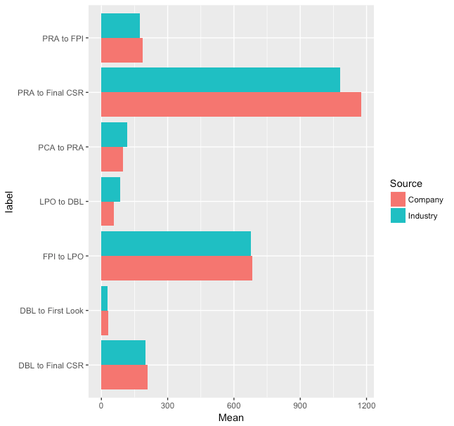
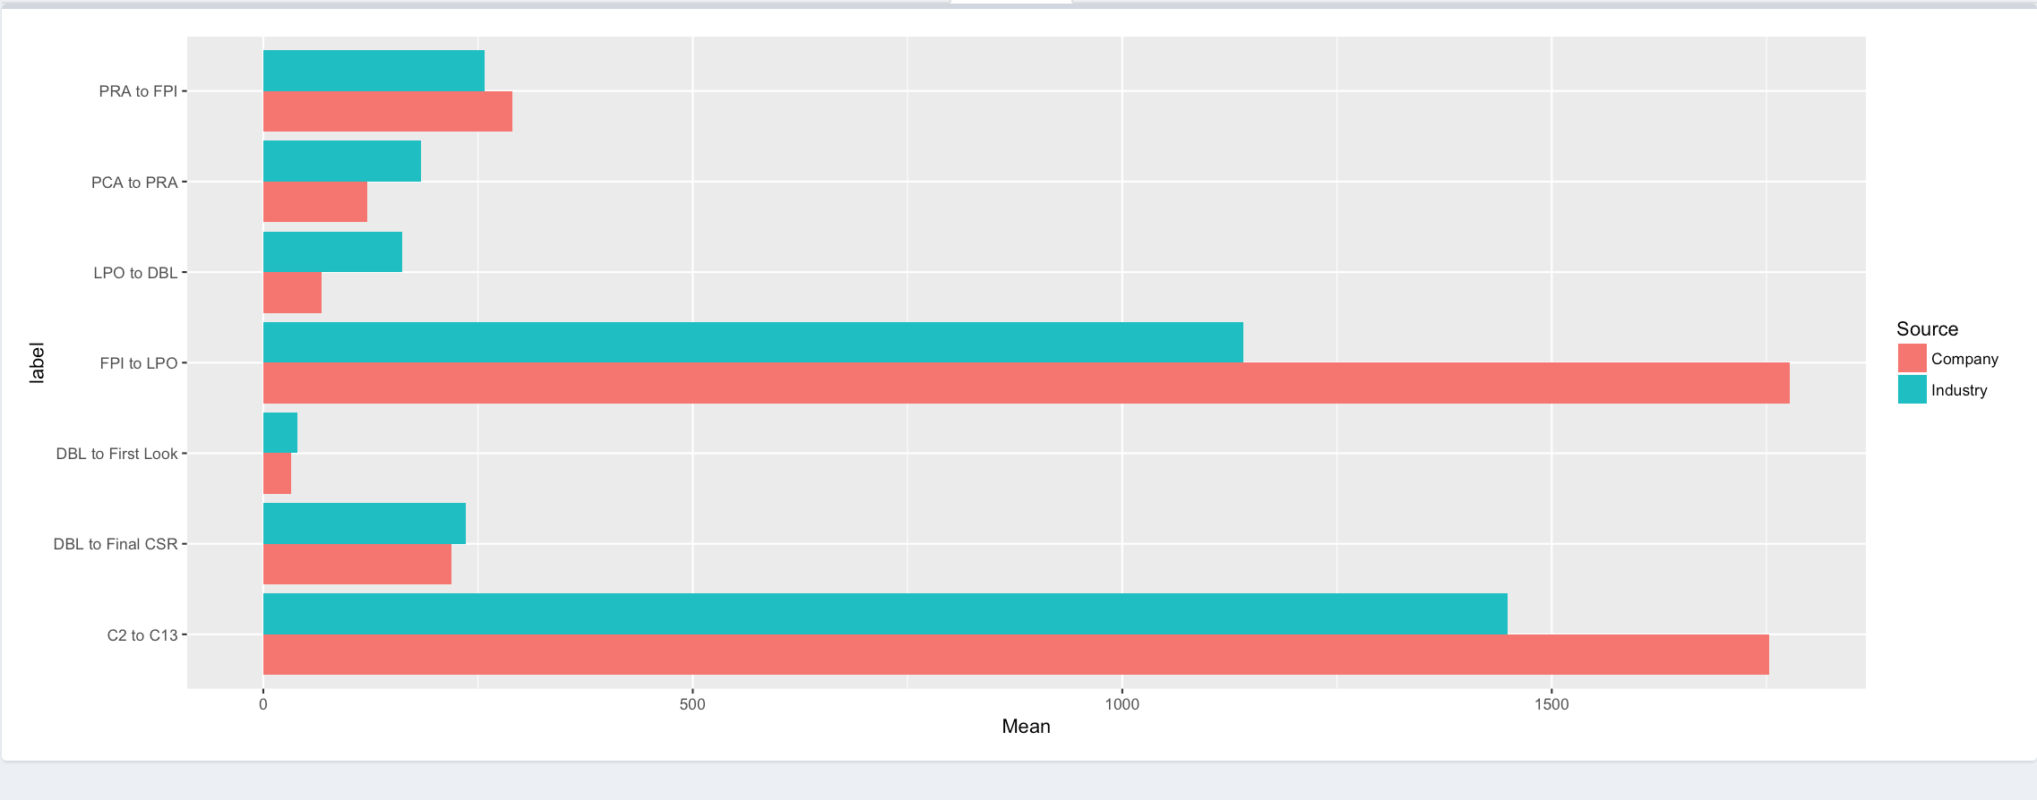
Cmr api
First iteration was just ggplots and iterating with client on necessary parameters, don’t need thousands of indications
Notes:
Add more charts

Slide 15
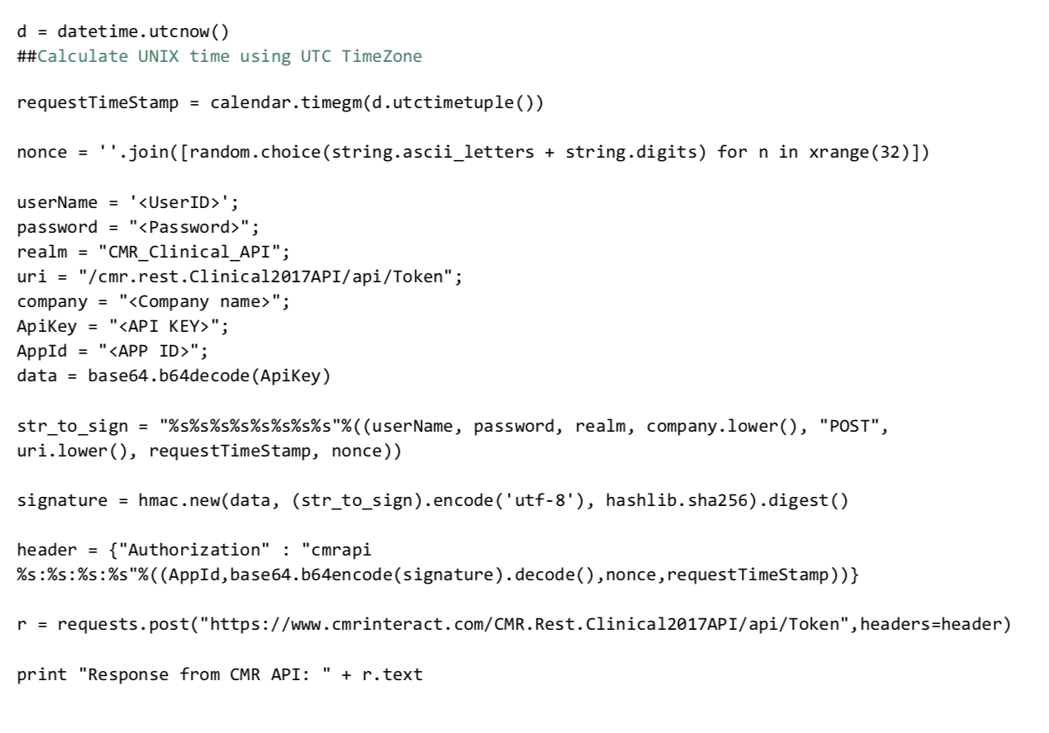
Authentication (python! Gasp!)
“The point of being done is not to finish but to get other things done.”
Notes:
Fastest way to get the data, python auth code example in their docs

Slide 16
How it works
get_token()
cmr_api.R
reticulate
auth.py
returns token
“Once you’re done you can throw it away.”
server.R
ui.R
fetch_data(token, endpt, params)

Slide 17
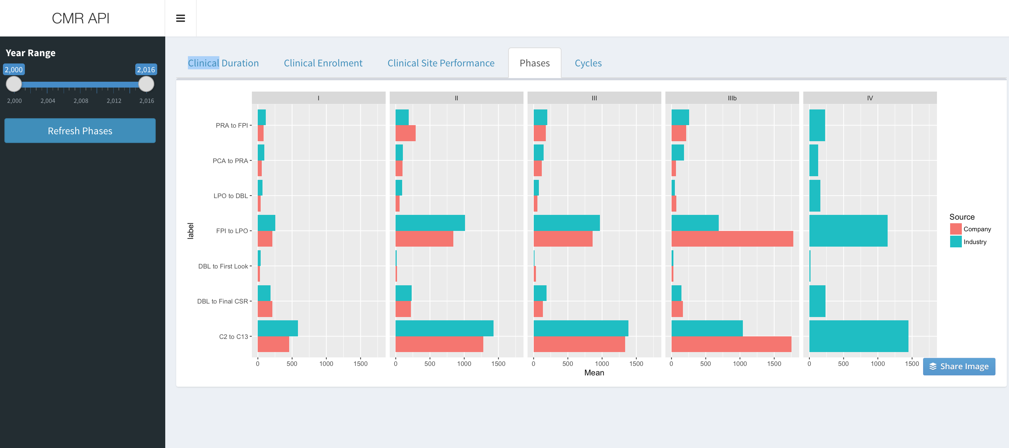
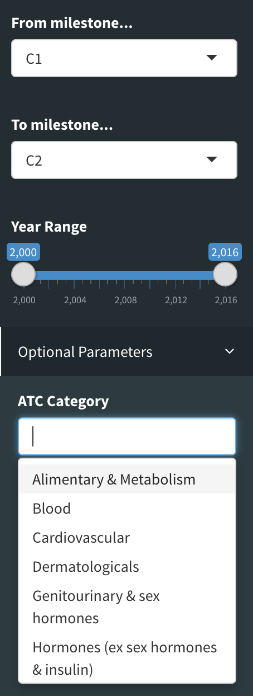
Current product

Slide 18
Drug manufacturing
Many combinations of raw materials in specific order used to create final drug substance
Time Consuming
Costly
One problematic substance = lost batches = millions of dollars
Single user was running 100s of SQL queries manually

Slide 19
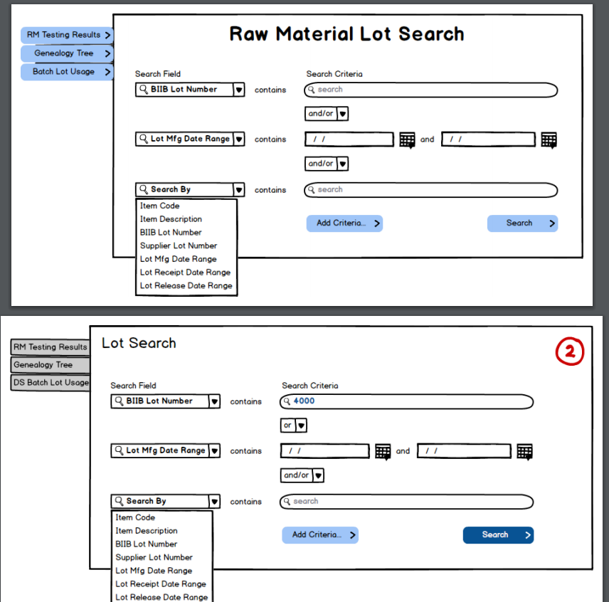

Slide 20
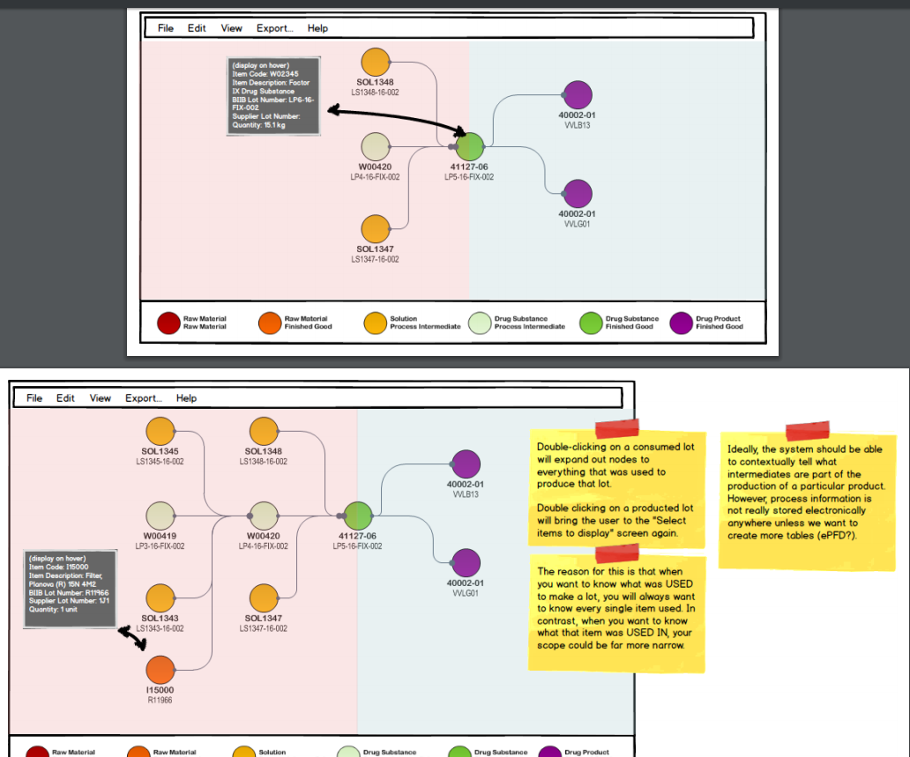

Slide 21
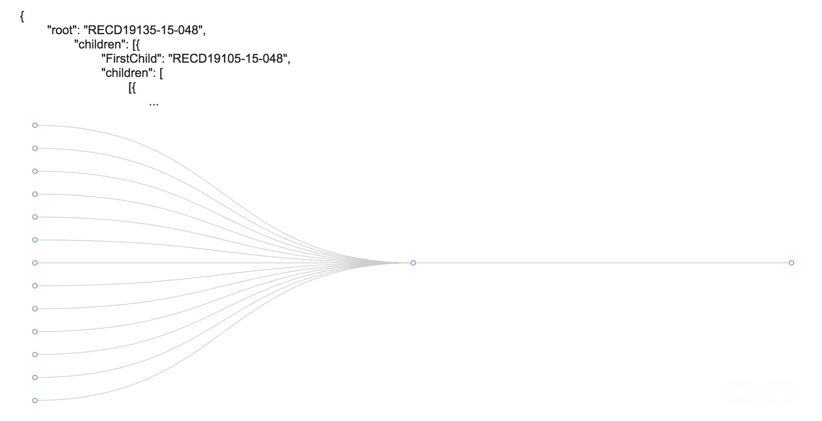
networkd3
“People without dirty hands are wrong. Doing something makes you right.”

Slide 22
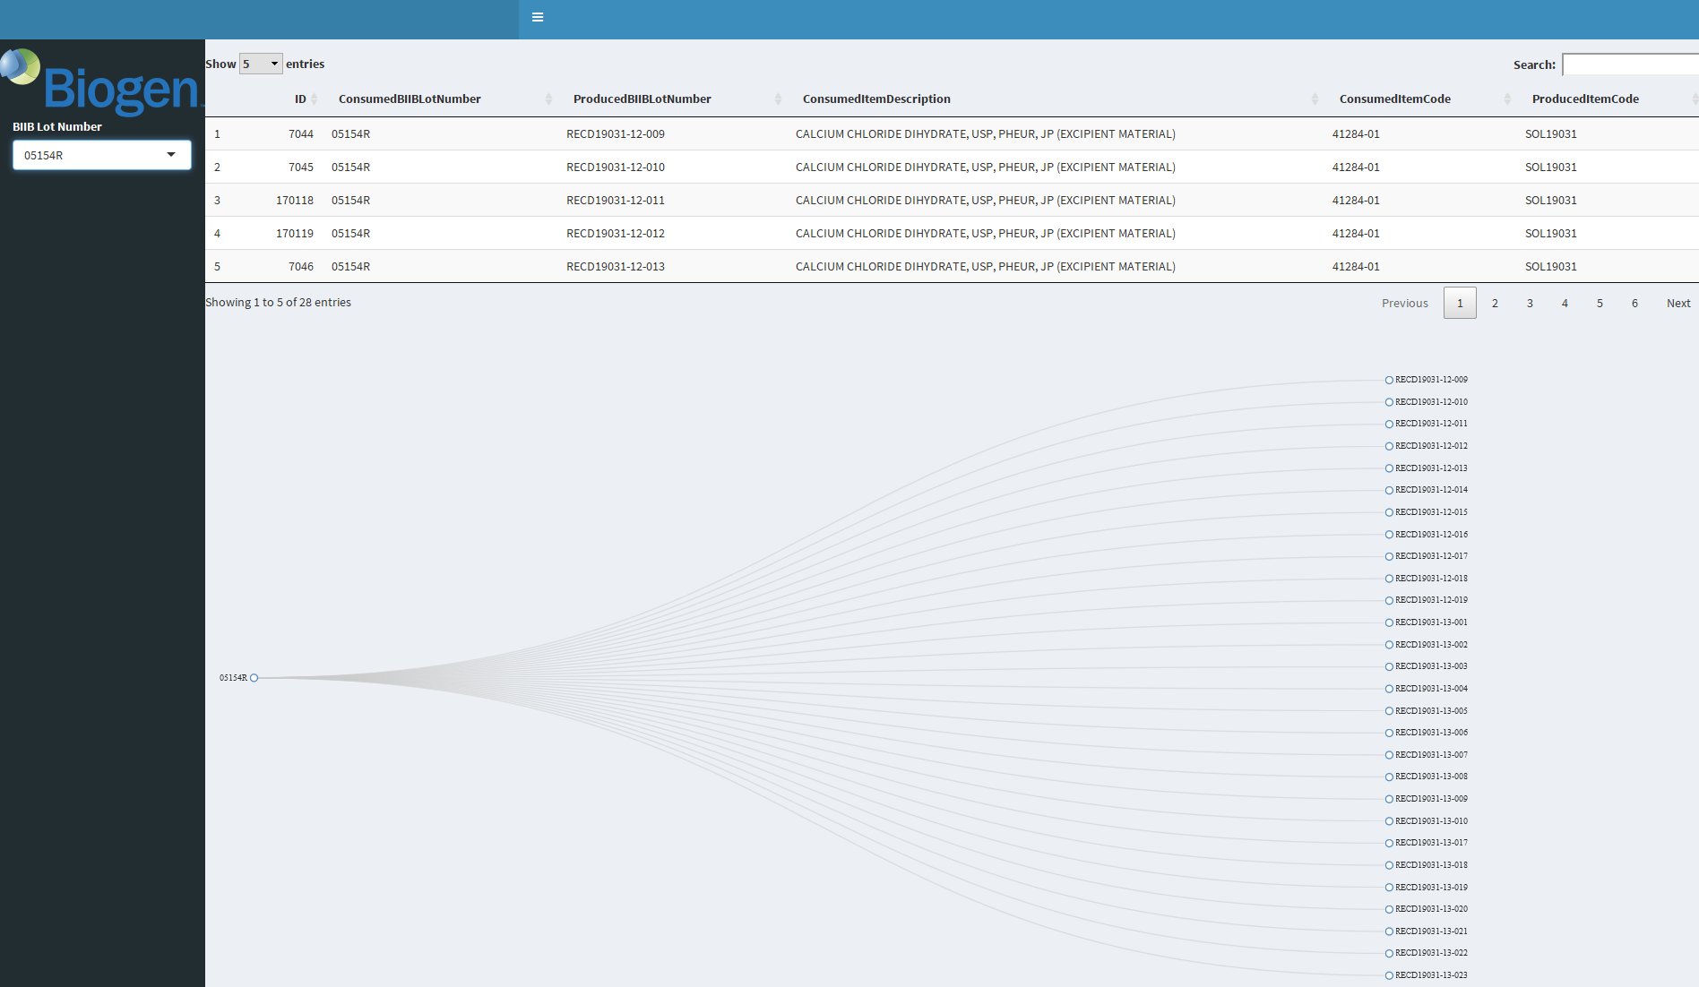
First version – core functionality
“There is no editing stage.”
Notes:
networkD3 wasn’t enough needed more customization

Slide 23
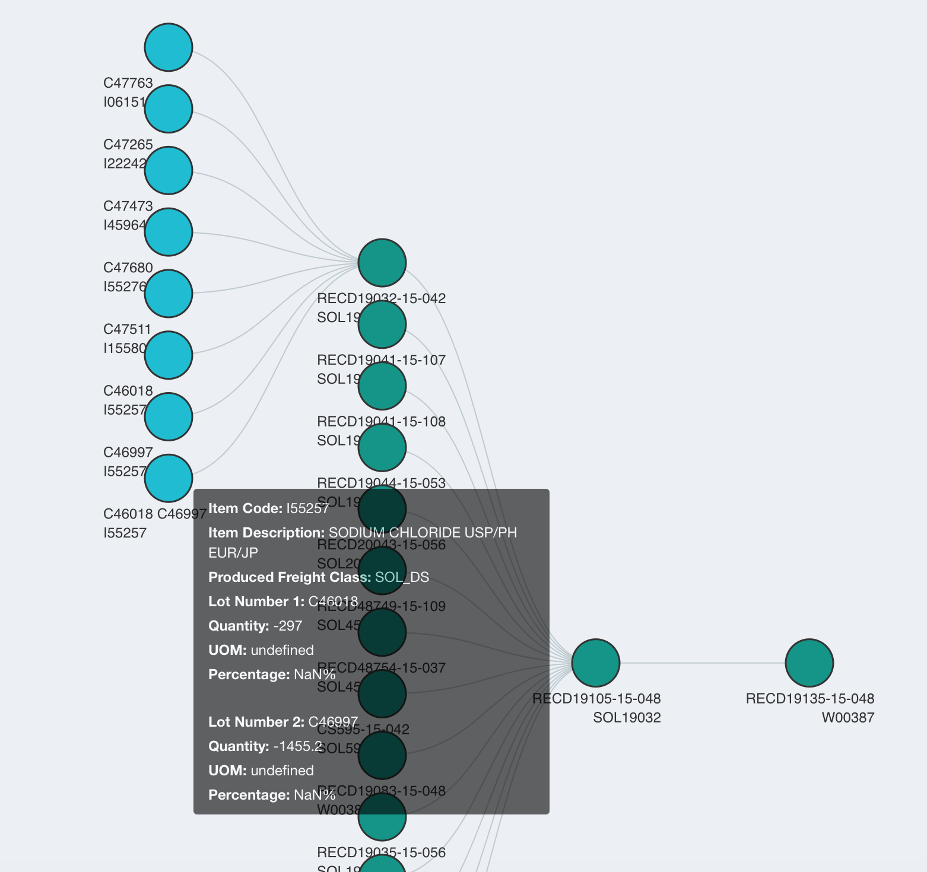
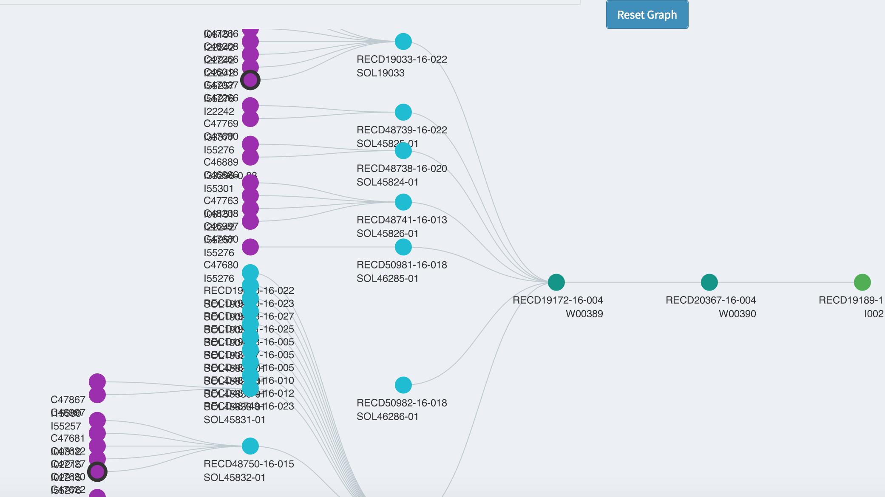
Details come later
“Failure counts as done. So do mistakes.”
Notes:
Need a bi-directional tree, colors showed up that the client didn’t know existed!

Slide 24
Shiny and d3 communication
server.R: session$sendCustomMessage(type="jsondata",var_json)
www/: main.js
Shiny.addCustomMessageHandler("jsondata", function (message) {
if (typeof(message) !== 'undefined') {
var json_data = JSON.parse(message);
initTree(json_data.left);
initSide(json_data.right);
}
});
ui.R: tags$script(src=”main.js")
http://myinspirationinformation.com/visualisation/d3-js/integrating-d3-js-into-r-shiny/
Notes:
Send custom message to front-end
This searches for the custom message of the type “jsondata”. Then it takes the contents of the message, and assigns them to a java script variable, in this case json_data

Slide 25
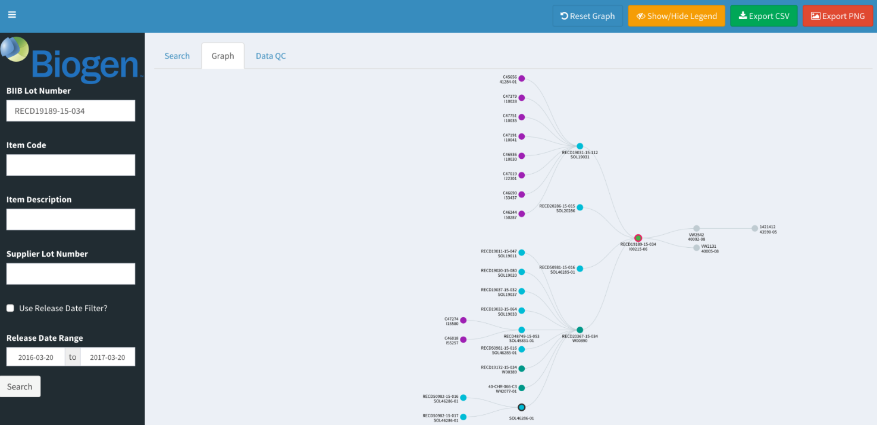
”final” product
Previously:
6 months and full team to identify problematic substance
Now:
1-2 users and 1 day to identify problematic substance

Slide 26

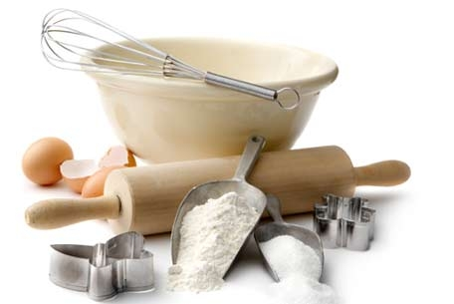

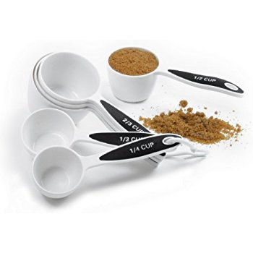

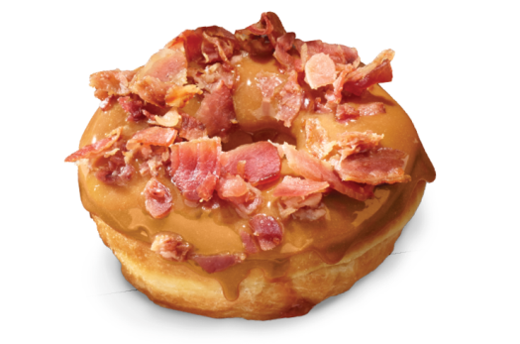
Overview of rapid prototyping process if we were making donuts

Slide 27

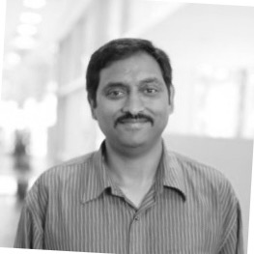

Thank you
Olivia
Brode-Roger
Patrick
Brophy
Daron
Carlson
Mike
Fitzpatrick
Rajesh
Mikkilineni
Jason
Tetrault
Roland
Zhou

